Slide 1
A proposal to investigate engineering solutions to reduce noise levels in Arada Kebab Restaurant
Tuna Dalbeler 21802539
ENG401-08

Slide 2
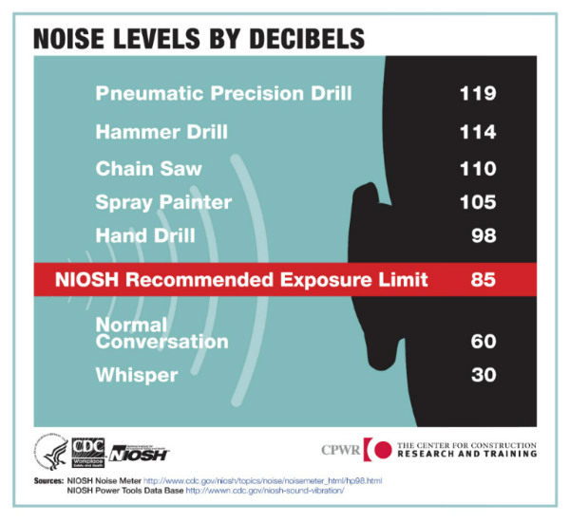
Intoduction
Zagat’s 2018 Dining Trends Survey of nearly 13,000 diners in the United States, the most irksome issue when it comes to dining out at was
noise (24%)
service (23%)
crowds (15%)
high prices (12%)
parking (10%) [2]
Figure 1: Noise Infographic by CDC [1]

Slide 3
Introduction
In a survey,
30% found their last dining experience too loud
24% regularly have to raise their voices to be heard
44% will choose a restaurant based on whether it is noisy or not
81% will not stay as long in a noisy restaurant
5% of responders suggested that they are more likely to use a takeaway than eat-in as the noise in restaurants has become uncomfortable [3]

Slide 4
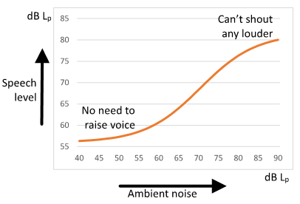
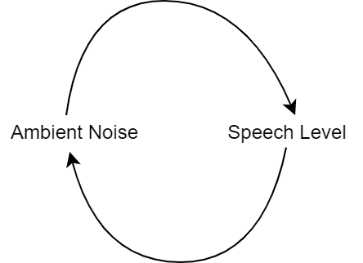
Lombard Effect
In a noisy environment people speaks louder. Which creates a noisier environment.
Figure 2: Lombard Effect [3]
Figure 3: Lombard Effect Causation Diagram

Slide 5
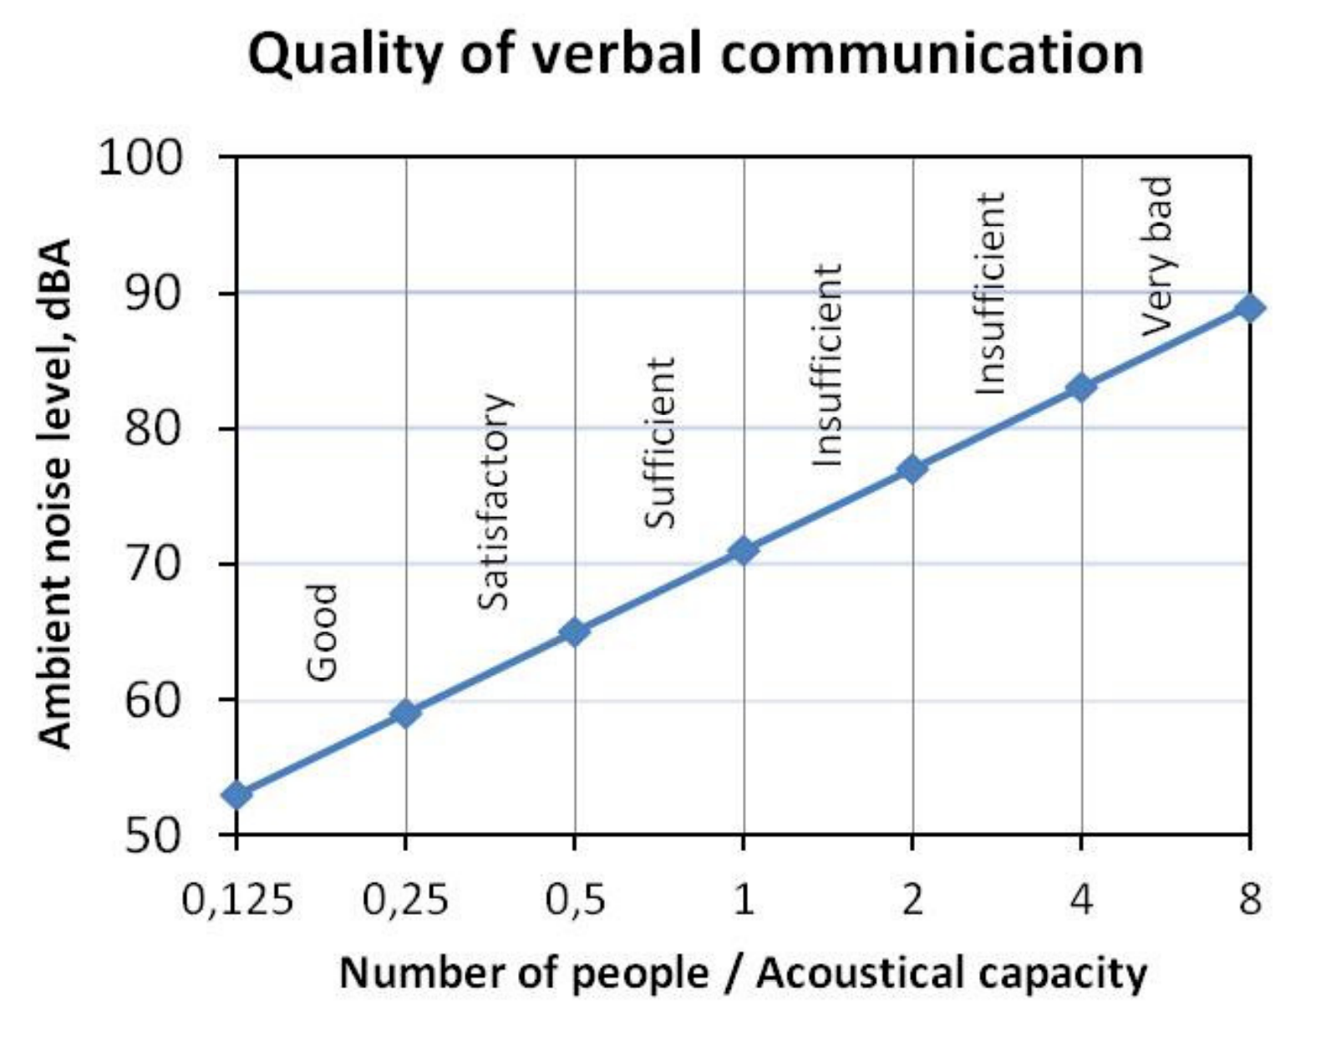
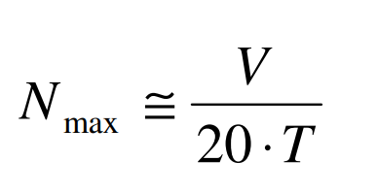
Reverberation Time
How long a sound stays in the room without fully absorbed (Simplified). One of the main contributors of ambiant noise.
Recomended «Acoustical Capacity» [4]
V = Volume (m^3)
T = Reverb Time
N= Num of People
Fig 4: Ambient noise level and quality of verbal communication as functions of the number of people relative to the Acoustical Capacity. [4]

Slide 6
Introduction
Purpose
Reduce the noise levels in Arada Kebab Restaurant.
Impact
Create a good environment for conservation quality.
Significance
Create a much more enjoyable dining experience in Arada Kebab Restaurant.

Slide 7
Problem Definition
Study Area: Arada Ocakbaşı Bahçelievler (Kebab Restaurant)
Has 20 tables. Approx ~ 100 Person
Peak: 93 dB, Average: 78-82 dB
Problem: Too much ambiance (environmental) noice creates a low quality communucation for customers and staff.

Slide 8
Problem Definitition
Causes of the problem:
Reverberation time
Loud Music
Loud Air Conditioning Units

Slide 9
Proposed Solutions
1. Acoustically Absorbent Wall Panels and Flooring
2. Smart Music Control System
3. Quieter Air Conditioning Units

Slide 10

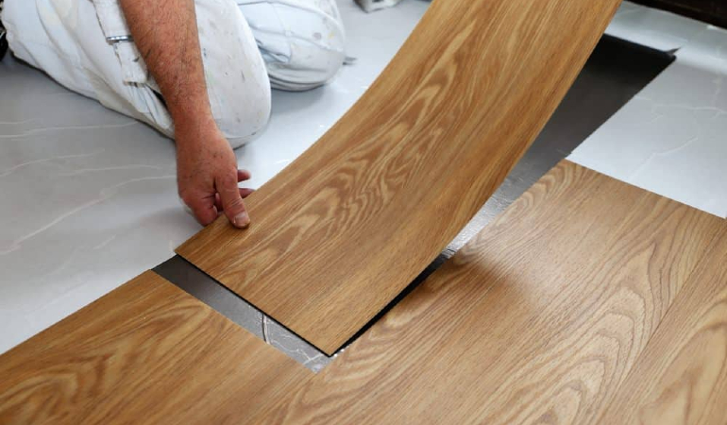
Acoustically Absorbent Wall Panels, Flooring
Aim: Reduced Reverberation Time
Flooring: Epoxy, Vinyl, Cork
Figure 5: Sound Panels Disguised [5]
Figure 6: Vinyl Flooring [6]

Slide 11
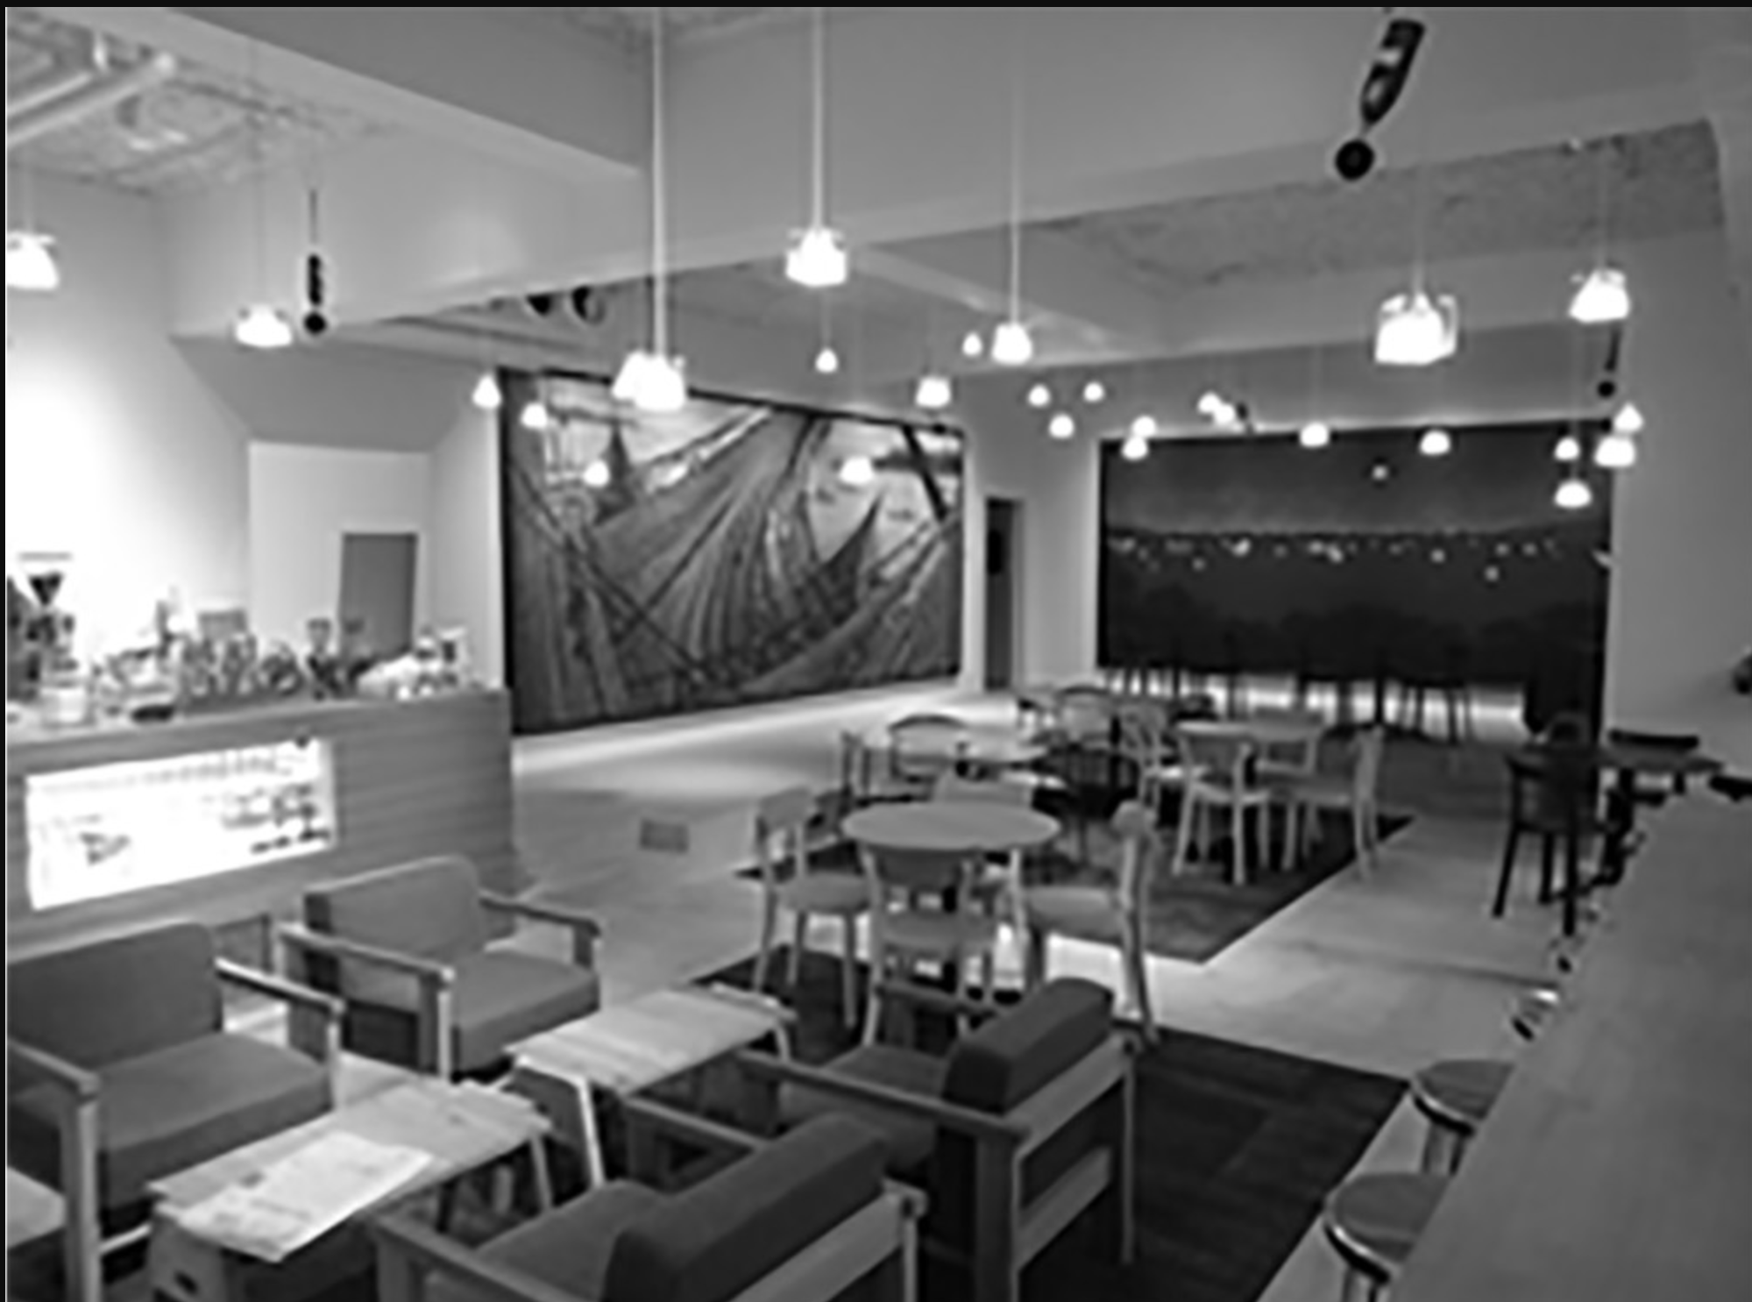
Smart Music Control System
Controls music sound level considering current loudness and customer count.
Microphones, proximity sensor and software
Why not turn it down completely?
Background music and background noise provides privacy. [7]
Figure 7: Installed Microphones in a dining area. [7]

Slide 12
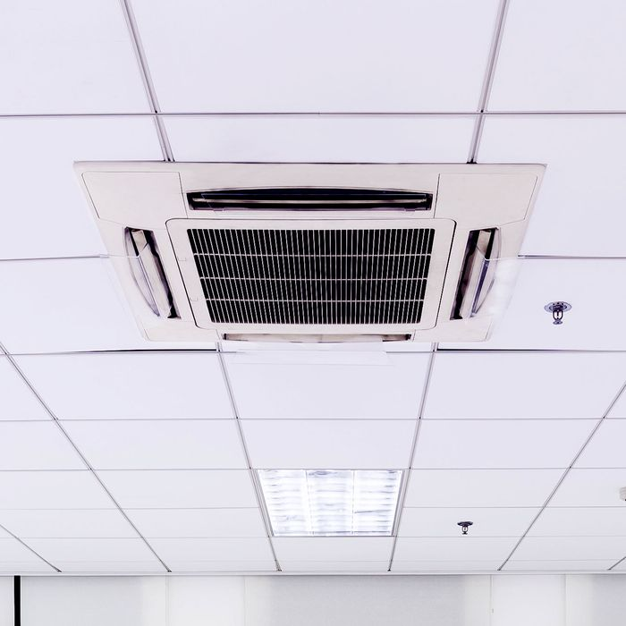
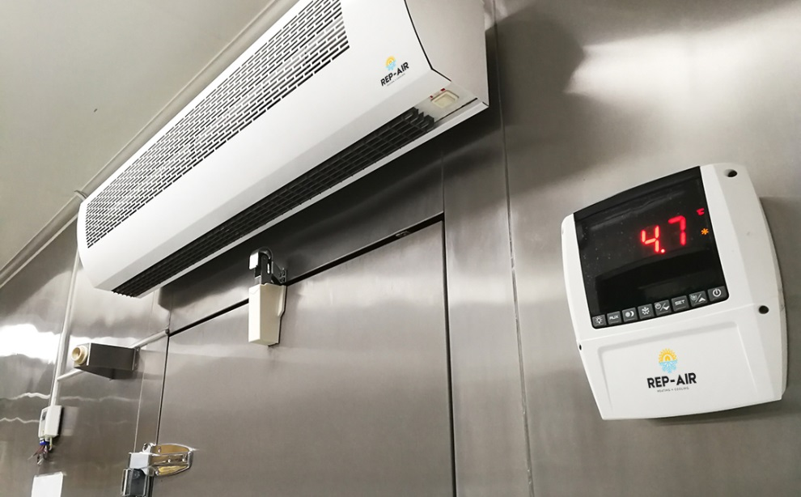
Quieter Air Conditioning Units
Currently the resaurant is equiped with very noisy fans, which are trying to take out smoke and other odors.
Also, has a loudly working huge Air Conditioning unit in the service area.
Figure 7: Cassette AC Unit.[8]
Figure 8: HVAC Unit with a termostat.[9]

Slide 13
Evaluation Criteria
Cost
Cost of the flooring and wall panels
Cost of the microphones, sensors and software
Cost of the Air Conditioning Units
Feasibility
The architectural permittable of new wall panels
The feasibility of installing microphones and sensors around the restaurant.
The architectural permittable of new AC units
Efficiency
The difference of reveb time if walls and floor are applied.
The efficiency of the software to control music to reduce sound levels of environment.
The Difference between sound levels of old AC and new planned AC

Slide 14



Proposed Research Methodology
Survey for customers
Literature research
Market Search

Slide 15
Referances
[1] «NOISE INFOGRAPHIC - LEVELS BY DECIBELS» Centers of Disease Control and Prevention. [Online]. Available: https://www.cdc.gov/niosh/topics/noise/infographic-noiselevels.html. [Accessed: November 1, 2021]
[2] «How Sound Panels Can Reduce Restaurant Noise Levels, Protect Employees’ Hearing, and Improve the Guest Experience» restauranttechnologynews.com. [Online]. Available: https://restauranttechnologynews.com/2019/09/how-sound-panels-can-reduce-restaurant-noise-levels-protect-employees-hearing-and-improve-the-guest-experience/ [Accessed: November 1, 2021]
[3] «The Lombard Effect» Harmoina Consulting. [Online]. Available: https://www.harmoniaconsulting.co.uk/noisy-restaurants [Accessed: November 1, 2021]
[4] Rindel, JH . Acoustical capacity as a means of noise control in eating establishments. In: Proceedings of BNAM 2012, Odense, 18–20 June 2012. [Online]. Available: https://odeon.dk/pdf/C116-BNAM_2012_Rindel_29.pdf [Accessed: November 1, 2021]
[5] «Acoustic Panels For Restaurants» sound-zero.com. [Online]. Available: https://sound-zero.com/acoustic-panels-for-restaurants/
[6] «Vinyl Flooring And Vinyl Floor Tiles: The 8 Pros And Cons» propertyguru.com [Online]. Available: https://www.propertyguru.com.my/property-guides/vinyl-flooring-and-vinyl-floor-tiles-pros-and-cons-48676 [Accessed: November 1, 2021]
[7]N. Maruyama et al. «Assessing the ease of conversation in multi-group conversation spaces: Effect of background music volume on acoustic comfort in a café» [Online]. Available: https://journals.sagepub.com/doi/full/10.1177/1351010X19897232 [Accessed: November 1, 2021]
[8] J. Davidson, «That Office AC System Is Great — at Recirculating Viruses» nymag.com [Online]. Available: https://nymag.com/intelligencer/2020/05/that-office-ac-system-is-great-at-recirculating-viruses.html [Accessed: November 1, 2021]

Slide 16
Referances
[9] «5 HVAC Tips for Restaurants Before the Holiday Rush» repairheatingandcooling.com [Online]. Available: https://repairheatingandcooling.com/5-hvac-tips-for-restaurants-before-the-holiday-rush/ [Accessed: November 1, 2021]

